Slide 1
Team_cenTinal
“InvestorBuddy”
- Praveen Kumar Yadav, Leader [9102558124] - Prashant Kumar Bhaiya, [7282961065] - Darshpreet Uppal, [9636324427] - Pragya Bansal, [6284197826]

Slide 2
Description of the Project
Approach to the Solution
Problem Statement
We are here to provide you a very basic financial plan where we divide your wealth in a fixed ratio among different Investment options and schemes so that you can achieve your short term, long term and retirement goals. Our calculators the give you an estimation of your plans accordingly.
Most of the people either have bad financial planning. They are unable to predict their returns due to complex calculations.
Hence they are lagging behind from getting benefitted from POWER OF COMPOUNDING
Relevance to the Theme
Techstack Involved
Our theme is open innovation and the idea is also an open idea which will be available to people for their benefits.
As for now we have designed the a prototype webpage to display the working and interface of the product. So for developing this web page we used tools such as HTML, CSS JAVASCRIPT and BOOTSTRAP

Slide 3
Growth Plan of the Product
10%
Gathering Information regarding investment schemes and developing a suitable financial plan.
Checkpoint 1
25%
We created a prototype web page to check the interface and the basic financial plan .
Checkpoint 2
50%
Developing another algorithm which will give unique financial plan to each individual based on their goals.
Checkpoint 3
Launching the product in the market as an full fledged working website “investorbuddy.com” accessible by general public.
75%
Checkpoint 4

Slide 4
Description of the Solution
Step 1
Step 2
Firstly we gathered information regarding all the existing investment options.
Then we selected the safest option with maximum returns and develop our model.
2021
Step 3
Step 4
Our team then engaged to find a way for presenting our model to people in an efficient way.
We created a website to deliver our financial plan

Slide 5
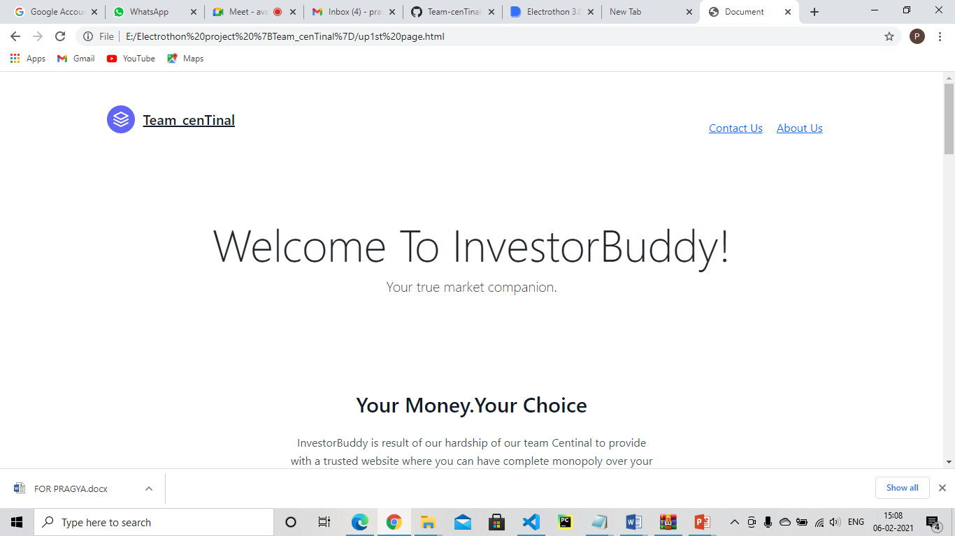
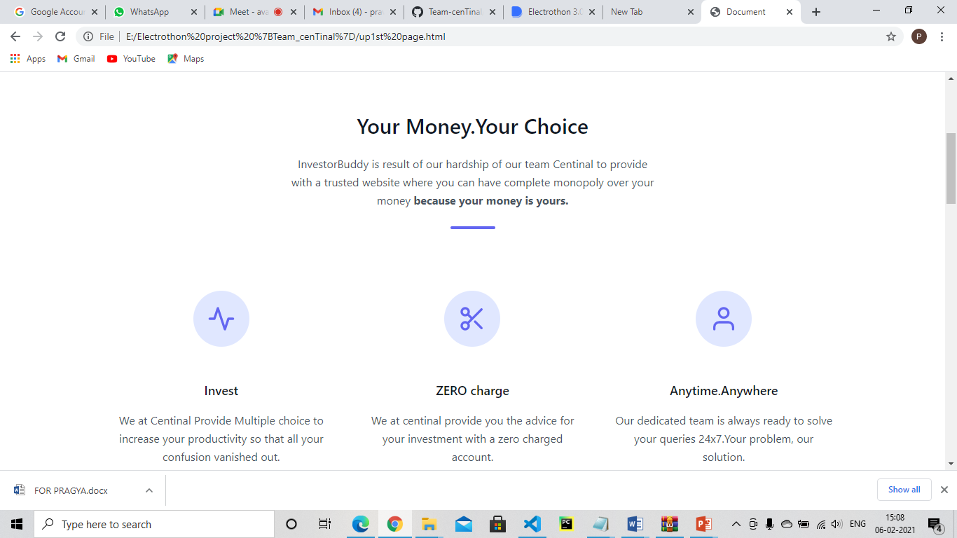
Working Prototype
https://github.com/Team-cenTinal/Investor-Buddy.git

Slide 6
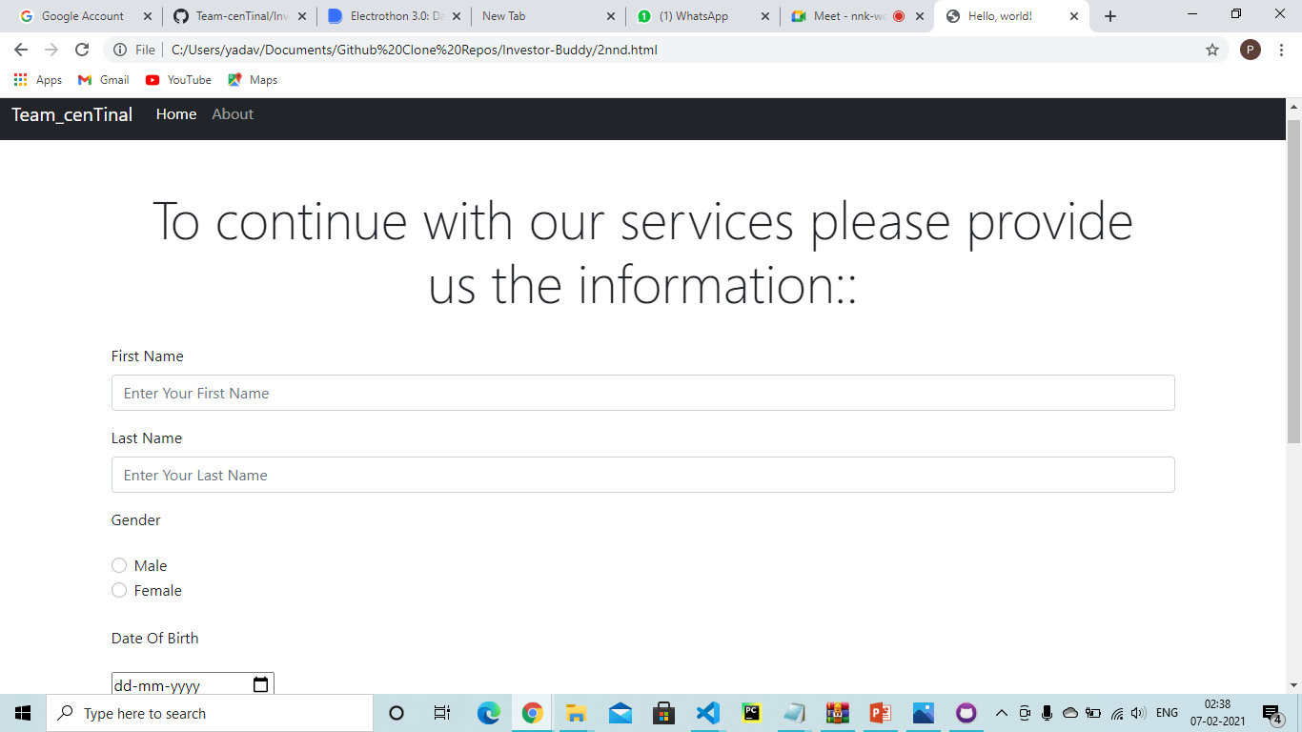
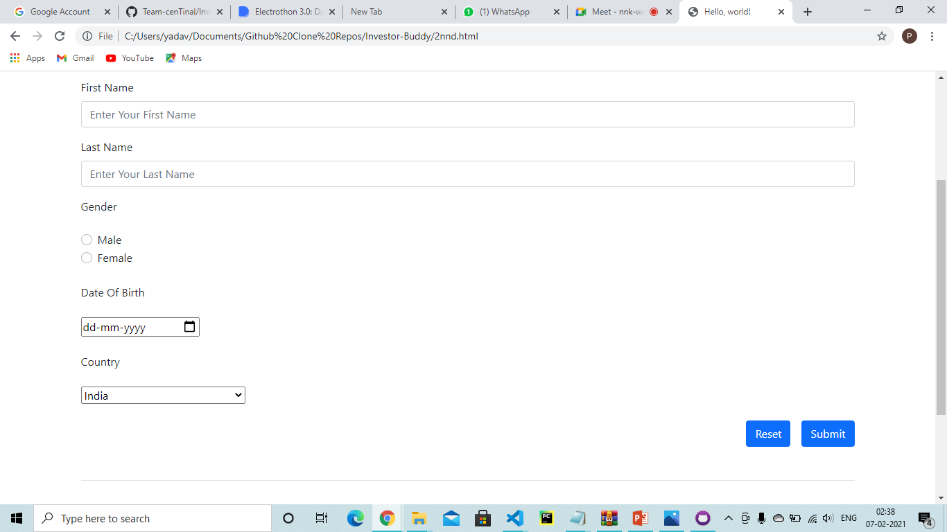

Slide 7
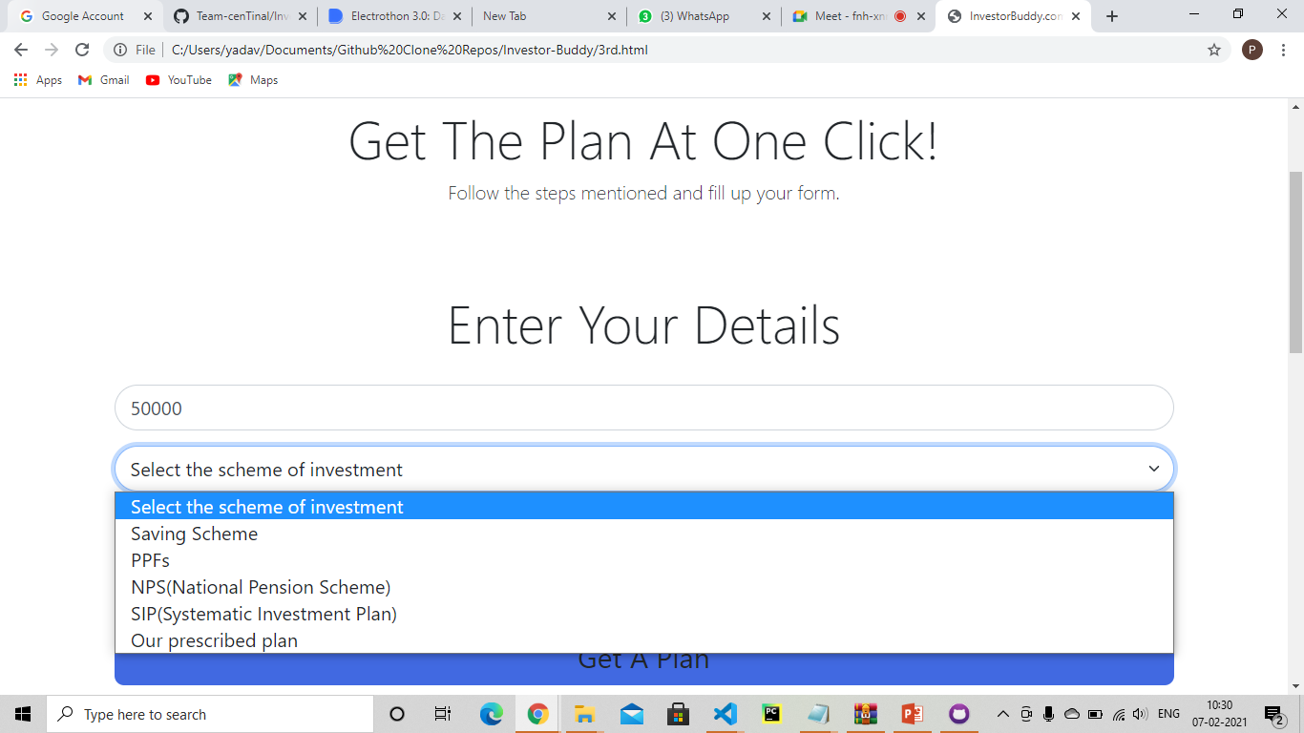

Slide 8
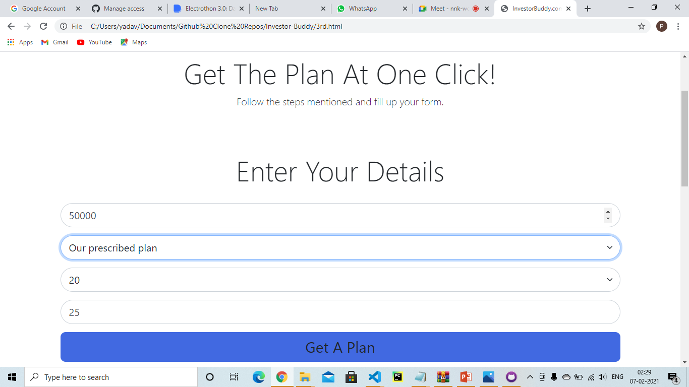

Slide 9
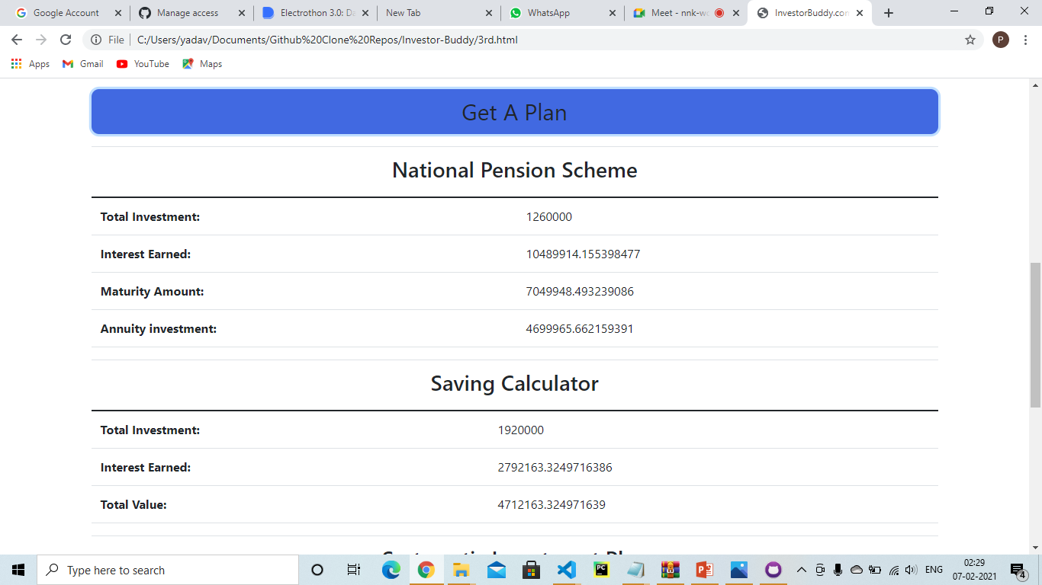

Slide 10
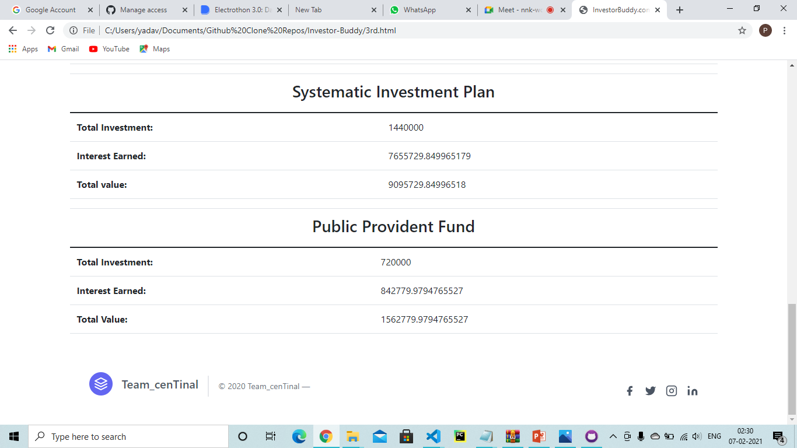

Slide 11
Details of Technology Stack
Tech1
HTML – We used this tool in developing the structure of web page we made.
Tech2
CSS and Bootstrap – These tools we used to build the webpage’s colors, design and templates and the icons.
Tech3
JAVASCRIPT- This tool we used to design the backend of the website such as linking the pages associated with proceed and submit buttons and mainly the formula and algorithm of the calculator
VISUAL STUDIO CODE - We used this IDE For coding , writing script, algorithms and all of the testing and compilation.
Tech4

Slide 12
Business Aspects of the Hack
our product will open doors for new investors into the market who were relying on their savings to meet their goals by showing them better options and plans.
01
Market Impact
Target Consumers
02
Middle income and Low income groups who don’t have much financial knowledge and planning.
03
Financial Sustainability
We will generate by charging subscription fee and advertising.
As we know peoples goal so we can advertise accordingly
Product > Project
04
We have just developed a prototype of the website we are intend to build that would be easily accessible to the public.

Slide 13
Novelty of the Solution
This is the only platform in the market which will give you a peek into the future to see how your investments will perform so that you can manage your wealth and plans accordingly. It will help to conquer the mentioned problems :- 1.Beating Inflation rate 2. Having financial stability and security. 3.Enjoy early retirement 4.Avoid falling into a debt trap 5. Have decent savings to meet life goals.

Slide 14
Social Impact
Our idea can give a person his financial stability, he can be tension free for money in future and can have great lifestyle and good social life with his own planning. It can be also useful in any financial crisis.

Slide 15
Learning Curve
What have you learnt by doing this project?
04
01
Growth 1
We get to know why investing is important and why should everyone invest.
03
02
Growth 2
02
We get to know about various market schemes and investment options
01
03
Growth 3
Also we get to know how to present an idea digitally through web development using different coding languages.
04
Growth 4
Working as a team and learning about startup ideas.

Slide 16
About Team
01
02
Praveen Kumar Yadav
Prashant Kumar Bhaiya
Frontend developer
Backend Developer
03
04
Darshpreet Uppal
Pragya Bansal
Idea and model
Public Relations

